Slide 1
Microsoft Movie Studio Project
Nat Berryman

Slide 2
Summary
Descriptive analysis on current trends of the Movie Production industry to assist Microsoft in their venture to the movie making industry.
Explore opportunities to partner with existing successful production studios
Identified genres that generate most revenue
Identified most profitable release date patterns

Slide 3
Outline
Business Problem
Data
Methods
Results
Conclusions

Slide 4
Business Problem
Microsoft have decided to create a new movie studio and need assistance in identifying the best performing movies at the box office and what trends are present.
Identify best performing studios
Identify what Genre is performing well
Identify any release date patterns

Slide 5
Data
Number of movie release by year (2010-2018)
Data was modelled on movie releases by genre, studio, release dates along with domestic & world-wide revenue
Movies without revenue reports were excluded

Slide 6
Methods
To determine results;
Four datasets were merged
Columns removed (duplicates) and added (profit/loss)
Values converted to ease analyis (release dates)
Data grouped by key metrics and evaluated based on ave profit or gross revenue

Slide 7
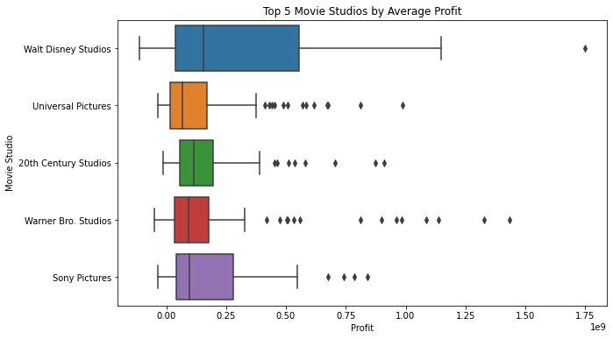
Results
On average, Walt Disney Studios is the most profitably movie studio followed by 20th Century Studios.

Slide 8
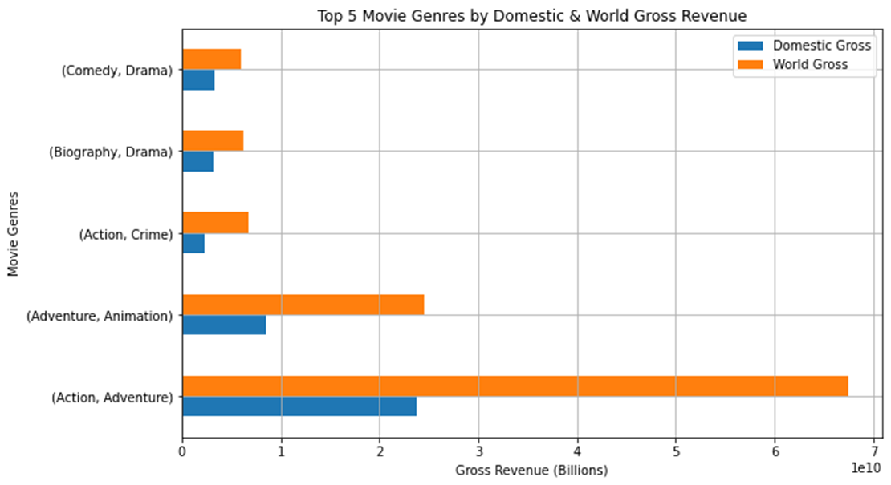
Results
Action/Adventure and Adventure/Animation genre movies attract the most box-office revenue.

Slide 9
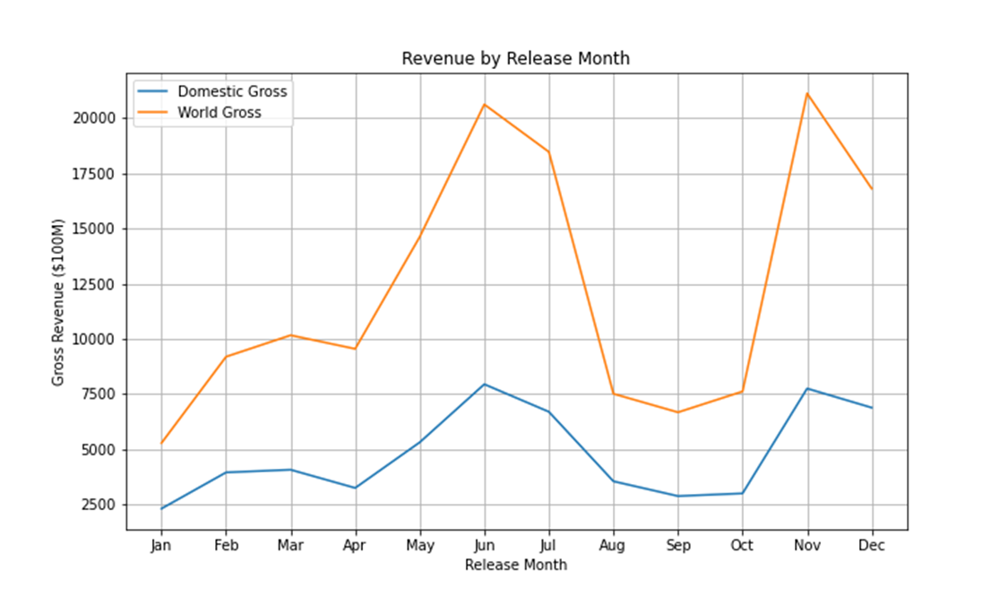
Results
Movies released in June and November yield the most revenue

Slide 10
Conclusions
For Microsoft to make a successful pitch the below recommendations are encouraged
Create Action genre movies with Adventure or Animation sub-genres
Release films in June and November
Investigate any partnership opportunities with established production studios Walt Disney Studios, 20th Century Studios, Sony Pictures, Warner Brothers or Universal.
The evaluation has identified profitable movie studios and high gross revenue returns however this would require expensive investment. There is also a possibility that established movie studios may not be interested in partnership opportunities. It is suggested Microsoft would benefit from further data analysis. Examples may include exploring smaller budget and/or foreign film markets as this may still yield attractive profits.

Slide 11
Thank You!
Email: nathaniel.berryman@gmail.com
GitHub: @natberr
LinkedIn: linkedin.com/in/nathaniel-berryman/

